Slide 1
Database Systems
AICT005-4-1-Database Systems (version1)
Week 8: Database Normalization

Slide 2
Topic & Structure of The Lesson
Functional dependency
Un-Normalized form
First normal form
Second normal form
Third normal form

Slide 3
Learning Outcomes
At the end of this topic, You should be able to
Describe functional dependency
Perform database normalization

Slide 4
Key Terms You Must Be Able To Use
If you have mastered this topic, you should be able to use the following terms correctly in your assignments and exams:
UNF
1NF
2NF
3NF
Partial dependency
Transitive dependency

Slide 5
Database Tables and Normalization
Normalization
Process for evaluating and correcting table structures to minimize data redundancies
Reduces data anomalies
Works through a series of stages called normal forms:
First normal form (1NF)
Second normal form (2NF)
Third normal form (3NF)

Slide 6
Database Tables and Normalization (continued)
Normalization (continued)
2NF is better than 1NF; 3NF is better than 2NF
For most business database design purposes, 3NF is as high as we need to go in normalization process
Highest level of normalization is not always most desirable

Slide 7
The Need for Normalization
Example: Company that manages building projects
Charges its clients by billing hours spent on each contract
Hourly billing rate is dependent on employee’s position
Periodically, report is generated that contains information displayed in Table 5.1

Slide 8
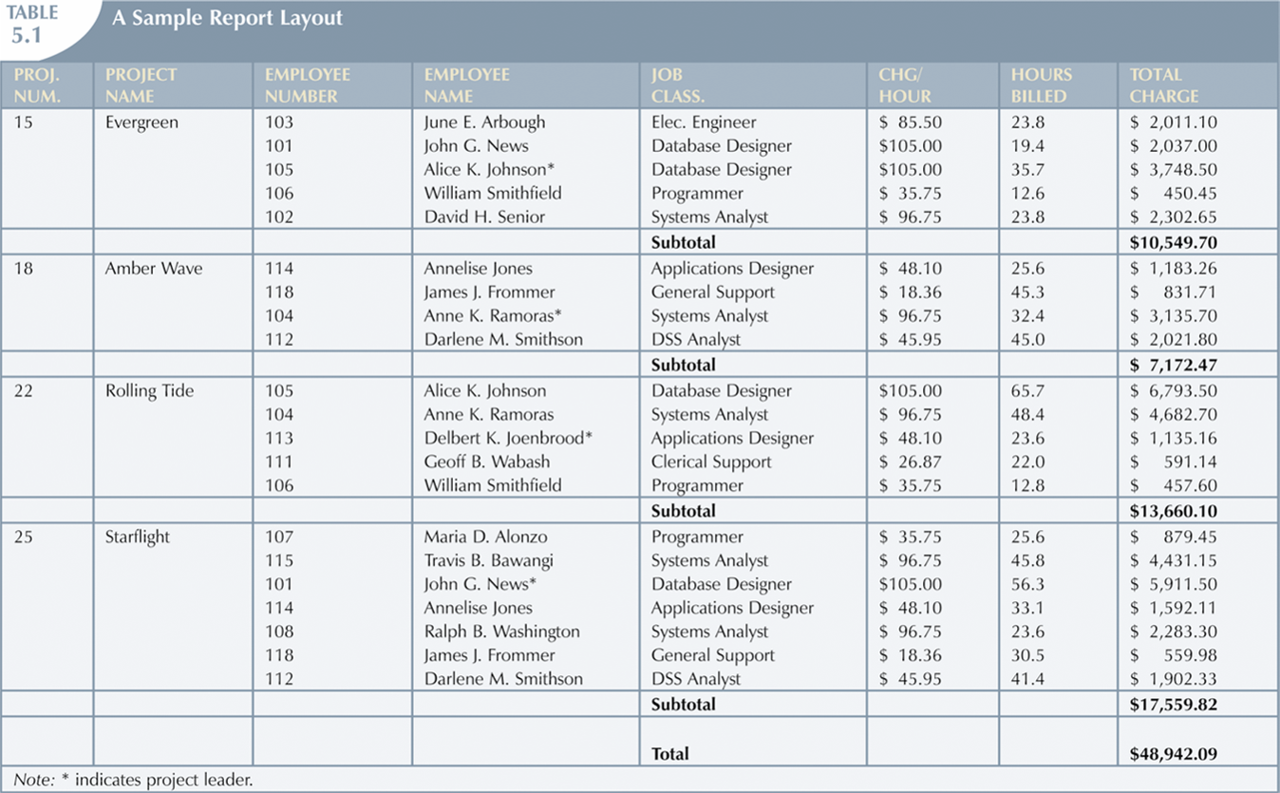
The Need for Normalization (continued)

Slide 9
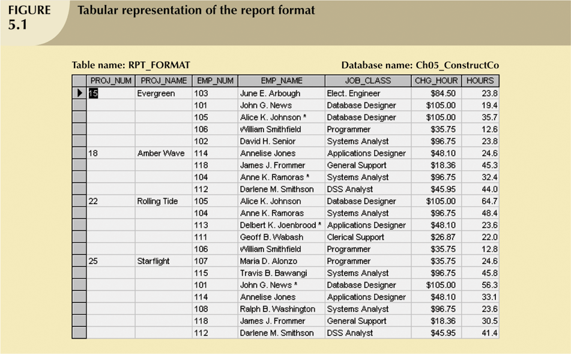
The Need for Normalization (continued)

Slide 10
The Need for Normalization (continued)
Structure of data set in Figure 5.1 does not handle data very well
The table structure appears to work; report generated with ease
Unfortunately, report may yield different results depending on what data anomaly has occurred

Slide 11
The Normalization Process
Each table represents a single subject
No data item will be unnecessarily stored in more than one table
All attributes in a table are dependent on the primary key

Slide 12
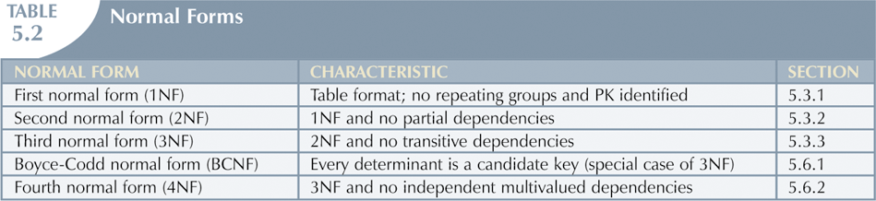
The Normalization Process (continued)

Slide 13
Conversion to First Normal Form
Repeating group
Derives its name from the fact that a group of multiple entries of same type can exist for any single key attribute occurrence
Relational table must not contain repeating groups
Normalizing table structure will reduce data redundancies
Normalization is three-step procedure

Slide 14
Conversion to First Normal Form (continued)
Step 1: Eliminate the Repeating Groups
Present data in tabular format, where each cell has single value and there are no repeating groups
Eliminate repeating groups, eliminate nulls by making sure that each repeating group attribute contains an appropriate data value

Slide 15
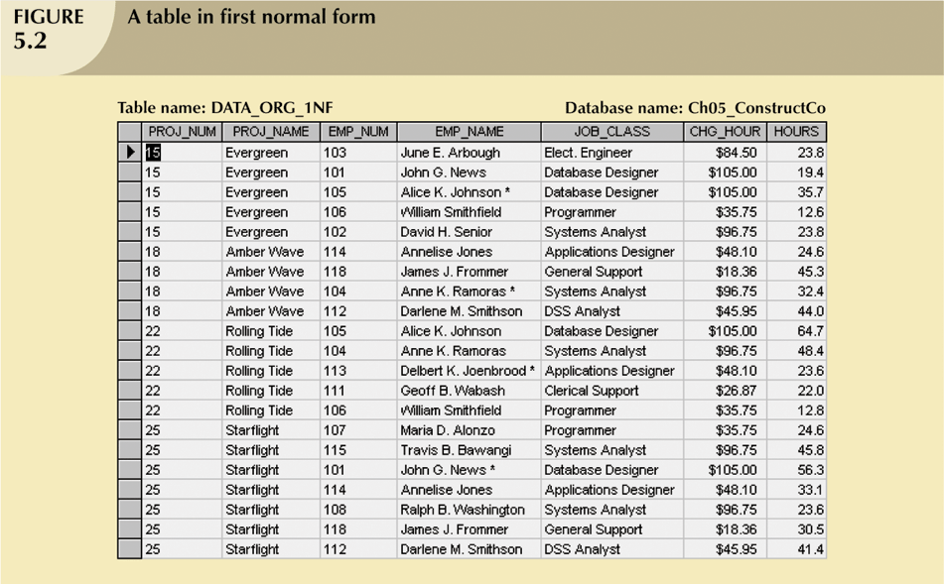
Conversion to First Normal Form (continued)

Slide 16
Conversion to First Normal Form (continued)
Step 2: Identify the Primary Key
Primary key must uniquely identify attribute value
New key must be composed

Slide 17
Conversion to First Normal Form (continued)
Step 3: Identify All Dependencies
Dependencies can be depicted with help of a diagram
Dependency diagram:
Depicts all dependencies found within given table structure
Helpful in getting bird’s-eye view of all relationships among table’s attributes
Makes it less likely that will overlook an important dependency

Slide 18
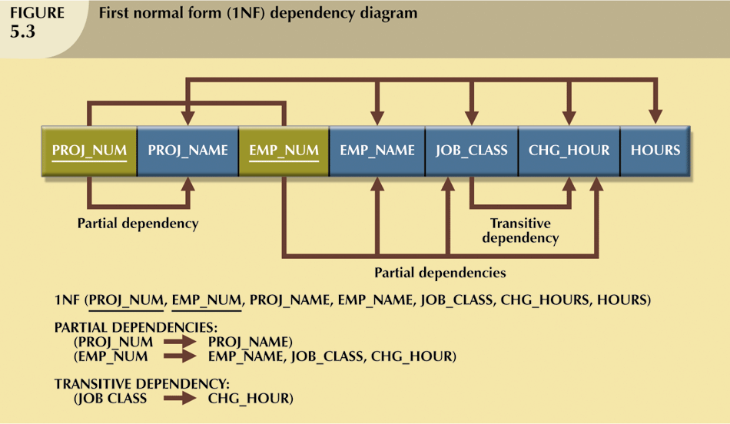
Conversion to First Normal Form (continued)

Slide 19
Conversion to First Normal Form (continued)
First normal form describes tabular format in which:
All key attributes are defined
There are no repeating groups in the table
All attributes are dependent on primary key
All relational tables satisfy 1NF requirements
Some tables contain partial dependencies
Dependencies based on only part of the primary key
Sometimes used for performance reasons, but should be used with caution
Still subject to data redundancies

Slide 20
Conversion to Second Normal Form
Relational database design can be improved by converting the database into second normal form (2NF)
Two steps

Slide 21
Conversion to Second Normal Form (continued)
Step 1: Write Each Key Component on a Separate Line
Write each key component on separate line, then write original (composite) key on last line
Each component will become key in new table

Slide 22
Conversion to Second Normal Form (continued)
Step 2: Assign Corresponding Dependent Attributes
Determine those attributes that are dependent on other attributes
At this point, most anomalies have been eliminated

Slide 23
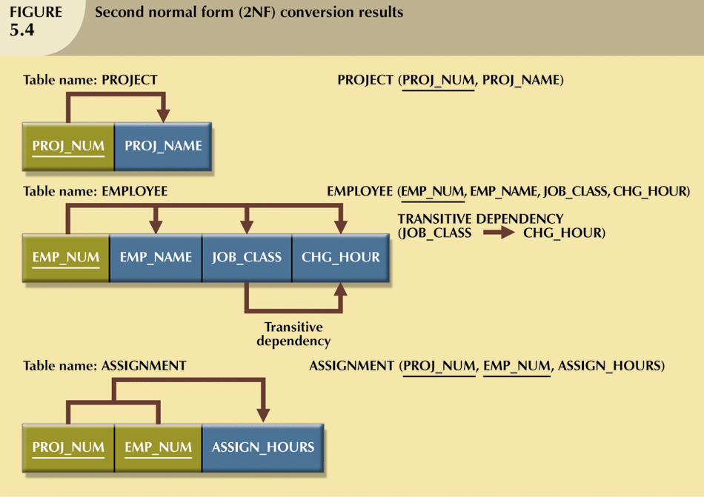
Conversion to Second Normal Form (continued)

Slide 24
Conversion to Second Normal Form (continued)
Table is in second normal form (2NF) when:
It is in 1NF and
It includes no partial dependencies:
No attribute is dependent on only portion of primary key

Slide 25
Conversion to Third Normal Form
Data anomalies created are easily eliminated by completing three steps
Step 1: Identify Each New Determinant
For every transitive dependency, write its determinant as PK for new table
Determinant
Any attribute whose value determines other values within a row

Slide 26
Conversion to Third Normal Form (continued)
Step 2: Identify the Dependent Attributes
Identify attributes dependent on each determinant identified in Step 1 and identify dependency
Name table to reflect its contents and function

Slide 27
Conversion to Third Normal Form (continued)
Step 3: Remove the Dependent Attributes from Transitive Dependencies
Eliminate all dependent attributes in transitive relationship(s) from each of the tables that have such a transitive relationship
Draw new dependency diagram to show all tables defined in Steps 1–3
Check new tables as well as tables modified in Step 3 to make sure that each table has determinant and that no table contains inappropriate dependencies

Slide 28
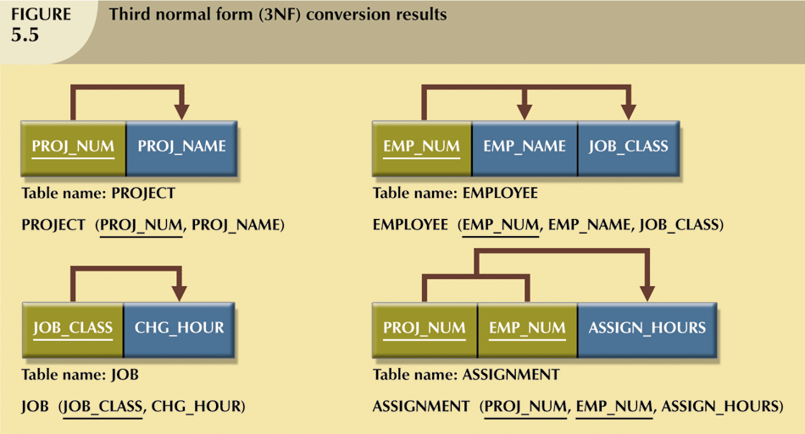
Conversion to Third Normal Form (continued)

Slide 29
Conversion to Third Normal Form (continued)
A table is in third normal form (3NF) when both of the following are true:
It is in 2NF
It contains no transitive dependencies

Slide 30
Quick Review Question
What is partial dependency?
What is transitive dependency?

Slide 31
Summary of Main Teaching Points
Normal forms can be transformed from lower normal forms to higher normal forms
Normalization and ER modeling are used concurrently to produce a good database design

Slide 32
Question and Answer Session
Q & A

Slide 33
What we will cover next
Structured Query Language (SQL)

